Slide 1

INTEGRATED CIRCUIT
___________________
BD7F100EFJ
VIN UVLO
LOAD COMPENSATION
_______________
Siouras Viktoras-Vikentios

Slide 2

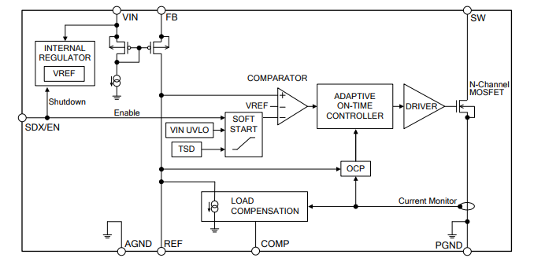
VIN UVLO
This is the input low-voltage-protection block
LOAD COMPENSATION
This is the block which compensates the output voltage regulation by VF characteristic fluctuation of the secondary side output diode according to the load current
Figure 1. BD7F100EF-EVK-002-U1 Block Diagram
Basic Principles of Power Electronics
Supervisor: Professor Nikolaos Papanikolaou

Slide 3
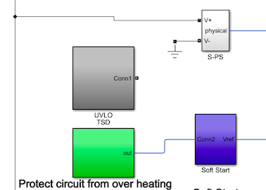
VIN UVLO
This is the input low-voltage-protection block. If the power supply input voltage, VIN, falls to below 2.5V, it will be detected and this block will be in the protection state and the SW terminal becomes Hi-Z.
Basic Principles of Power Electronics
Supervisor: Professor Nikolaos Papanikolaou

Slide 4
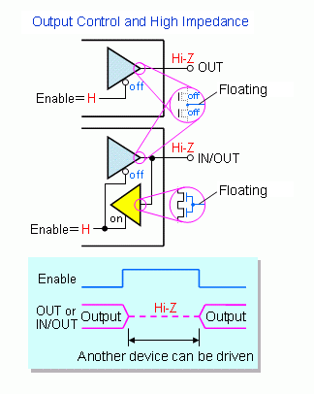
VIN UVLO (Hi-Z)
Hi-Z (or High-Z or high impedance) refers to an output signal state in which the signal is not being driven. The signal is left open, so that another output pin can drive the signal or the signal level can be determined by a passive device (typically, a pull-up resistor).
When the power supply input voltage (VIN) rises to 2.65V, it automatically recovers through the soft start. (Hysteresis voltage: 0.15V )
Basic Principles of Power Electronics
Supervisor: Professor Nikolaos Papanikolaou

Slide 5
VIN UVLO OPERATION
It is a kind of protection which stops IC's operation in order for the IC not to become under malfunction caused by the lower input voltage than the minimum operating voltage.
It stops the internal operation if the input voltage becomes lower than the detection voltage, and restarts it after the input exceeds the release voltage.
During the internal operation being stopped, the switching control unit and the reference voltage circuit, as well as the output voltage, are stopped.
Basic Principles of Power Electronics
Supervisor: Professor Nikolaos Papanikolaou

Slide 6
VIN UVLO BENEFITS
To prevent the UVLO itself from going wrong, this function has hysteresis
The UVLO works even at the start-up of power supply, and is therefore capable of preventing malfunction during the input voltage starting up.
Most of DC/DC converters are equipped with this UVLO function for safe and stable operation.
Basic Principles of Power Electronics
Supervisor: Professor Nikolaos Papanikolaou

Slide 7
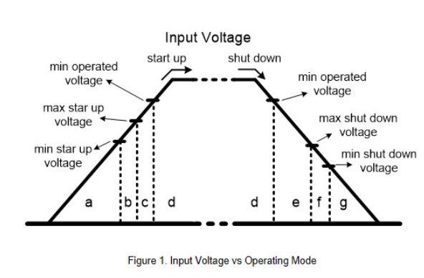
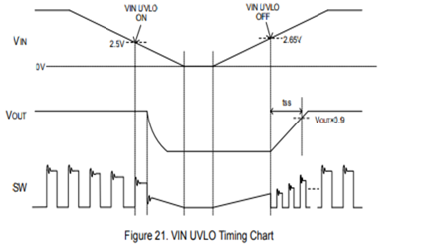
input voltage startup
the input voltage cutoff.
Basic Principles of Power Electronics
Supervisor: Professor Nikolaos Papanikolaou

Slide 8
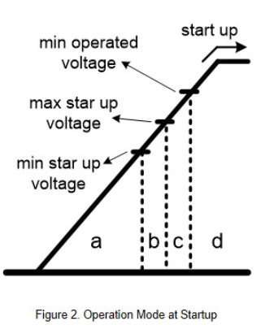
The startup portion can be divided into four operating modes.
When the input voltage is below the minimum startup voltage, the converter has no output.
When the input voltage is between the lowest and highest startup voltages, the converter cannot determine if it has started normally.
When the input voltage exceeds the maximum startup voltage, but still has not reached the minimum operating voltage, the converter has started, but not suitable for full load output.
When the input voltage is higher than the minimum operating voltage, the converter operates normally.
Basic Principles of Power Electronics
Supervisor: Professor Nikolaos Papanikolaou

Slide 9
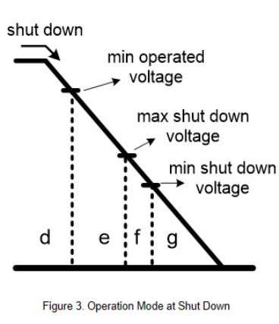
The shut down portion can be divided into four operating modes
D. The converter operated normally.
E. When the input voltage is lower than the minimum operating voltage, but still higher than the cutoff voltage, the converter is not turned off and is not suitable for it to continue full-load output.
F. When the input voltage is between the highest and lowest cut off voltages, the converter cannot determine if it has been normally turned off.
G. When the input voltage is lower than the lowest cutoff voltage, the converter shut down.
Basic Principles of Power Electronics
Supervisor: Professor Nikolaos Papanikolaou

Slide 10
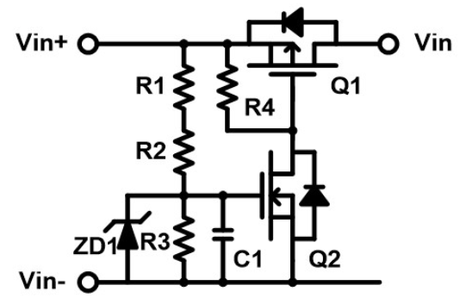

VIN UVLO CIRCUIT
The operation principle is when the input voltage reaches the setting value, the Q2 switch turns on and provides the normal operated voltage to converter.
Basic Principles of Power Electronics
Supervisor: Professor Nikolaos Papanikolaou

Slide 11
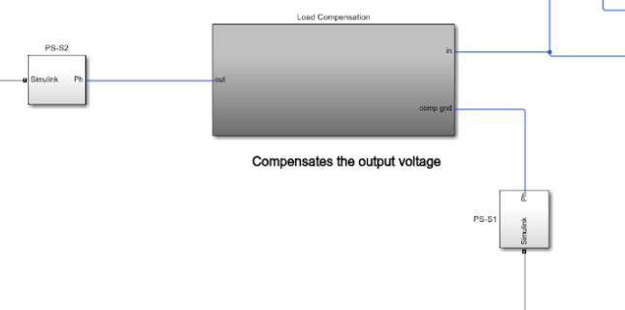
LOAD COMPENSATION
This is the block which compensates the output voltage regulation by VF characteristic fluctuation of the secondary side output diode according to the load current.
Basic Principles of Power Electronics
Supervisor: Professor Nikolaos Papanikolaou

Slide 12
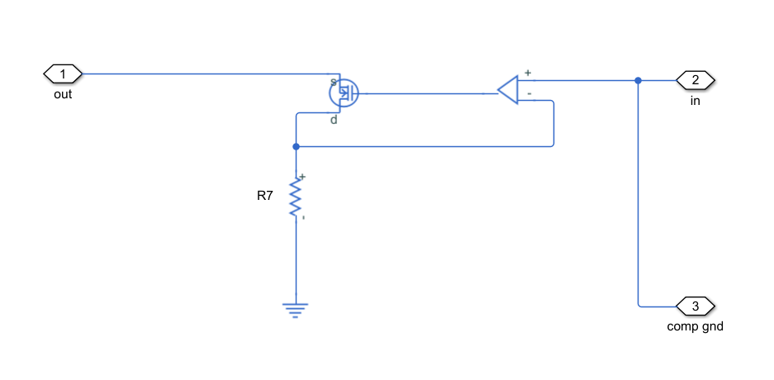
LOAD COMPENSATION(continued)
The current which flows into the built-in N-Channel MOSFET is monitored, and the current according to the compensation quantity and the time constant which are determined by the external resistor and the capacitor of the COMP terminal is drawn from the REF terminal. The output voltage rises and is rectified when feedback current which flows into the external resistor of the REF terminal decreases and the REF terminal voltage falls.
Basic Principles of Power Electronics
Supervisor: Professor Nikolaos Papanikolaou

Slide 13
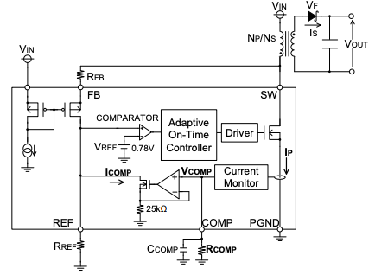
The relational expression of VOUT shows that VF and ESR are the factors leading to poor load regulation.To avoid these factors which causes problems, an ideal load regulation can be obtained using load compensation function.In the application wherein output voltage accuracy in particular is not required, load compensation function can be cancelled by short-circuiting the COMP terminal to GND.
Basic Principles of Power Electronics
Supervisor: Professor Nikolaos Papanikolaou

Slide 14
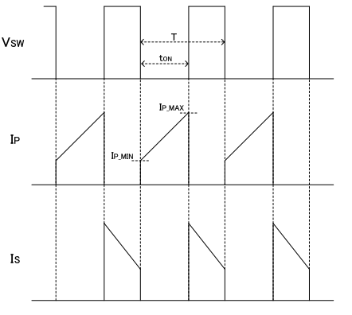

VOUT voltage drop is compensated corresponding to the average current of the primary transformer current IP. Since IP and IS have a relationship ,the load compensation value is determined by assuming IS from IP and then adjusted by using external CR of the COMP terminal. The current of K・IP is injected to the COMP terminal from the Current Monitor block and then converted to VCOMP through RCOMP resistor externally attached to COMP terminal.
Basic Principles of Power Electronics
Supervisor: Professor Nikolaos Papanikolaou

Slide 15

The current of K・IP is injected to the COMP terminal from the Current Monitor block and then converted to VCOMP through RCOMP resistor externally attached to COMP terminal.K here is the compression magnification and indicated as 1/50k. The upper limit of VCOMP operating voltage is limited in the internal circuit. Set RCOMP below 0.5V.
Basic Principles of Power Electronics
Supervisor: Professor Nikolaos Papanikolaou

Slide 16

Steep changes in ICOMP may make the operation of the loop unstable. Therefore, CCOMP is needed to stabilize VCOMP.
IP_ave = Average transformer primary side current
RCOMP= External resistance for ICOMP adjustment
tON = ON-Time of built-in N-Channel MOSFET
Basic Principles of Power Electronics
Supervisor: Professor Nikolaos Papanikolaou

